Slide 1
How To Not Fail with Apache Storm
Kit Menke
Adam Doyle
10/12/2017
Created 9/2015

Slide 2
Agenda
Storm 101
Development
Demo
Testing
Deployment
Implementation

Slide 3

Apache storm http://storm.apache.org/
System for processing streaming data in real time
Why would you use it?
Highly scalable – Amount of data to be processed will increase in the future
Fault tolerant – Must run 24/7, recover automatically from faults
Guaranteed processing – Need to process every tuple at least once or exactly once
“One message at a time” processing paradigm
Compare this with Apache Spark’s micro-batch processing

Slide 4
Example use cases
Sentiment
Clickstream
Machine/sensors
Logs
Geo-location
Stock trading

Slide 5
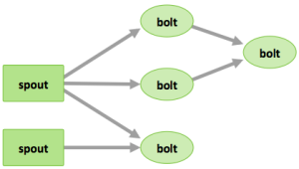
Components of a Topology http://hortonworks.com/hadoop/storm/#section_2
Tuples – an ordered list of elements
Streams – an unbounded sequence of tuples
Spouts – bring data in, create tuples
Bolts – process streams of data
Topologies – network of spouts and bolts

Slide 6
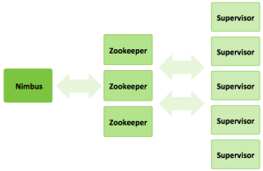
Storm cluster
Nimbus – master node, coordinates storm workers
Supervisors – talks to Nimbus, start/stop workers
Workers – running spouts/bolts
Executors – an instance of a spout/bolt
Notes:
Nimbus is like the “name node” in a normal map reduce cluster.
Supervisors are like the task trackers on each individual node.
Zookeeper for coordination
Worker

Slide 7
Storm cluster (cont.)
Node
A server in your cluster, runs workers
Workers
Each worker has its own JVM, runs executors
Executors
Each executor is assigned to a worker in the cluster, runs tasks
Tasks
Instances running your spout/bolt code

Slide 8
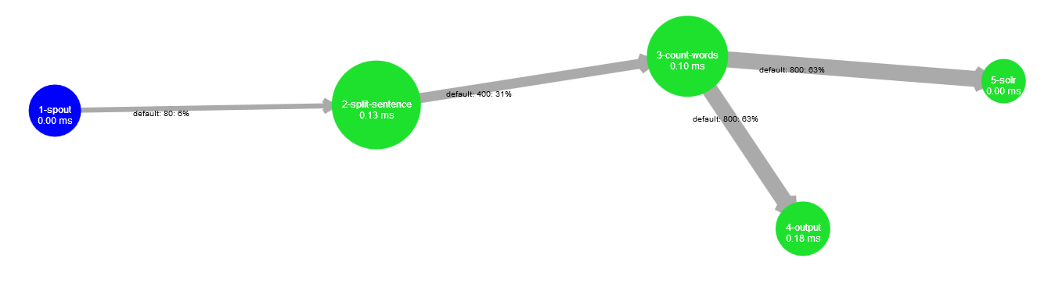
Development
Set up your DEV Environment: Eclipse/IntelliJ, Maven, Git
Use an example to get started: storm-starter or storm-stlhug-demo
Plan the topology
One spout per input
Split bolts in logical units of work
Common problems:
Managing connections, errors in flow, TickTuples, serialization
Notes:
Setup your environment. Hadoop is very JVM based so the easiest to get started with is Eclipse (for a java topology), Maven, and Git.
Use some example code to get started. Get comfortable with the process of building and deploying.
Tick Tuples – can use to refresh something on a periodic basis

Slide 9
Execution flow
First, when your topology is started...
Create Spouts and Bolts
declareOutputFields
Spouts/Bolts serialized and assigned to workers
Second, in each worker somewhere on the cluster...
Spouts open and Bolts prepare (happens once)
In a loop...
Spouts call ack, fail, and nextTuple
Bolts call execute

Slide 10
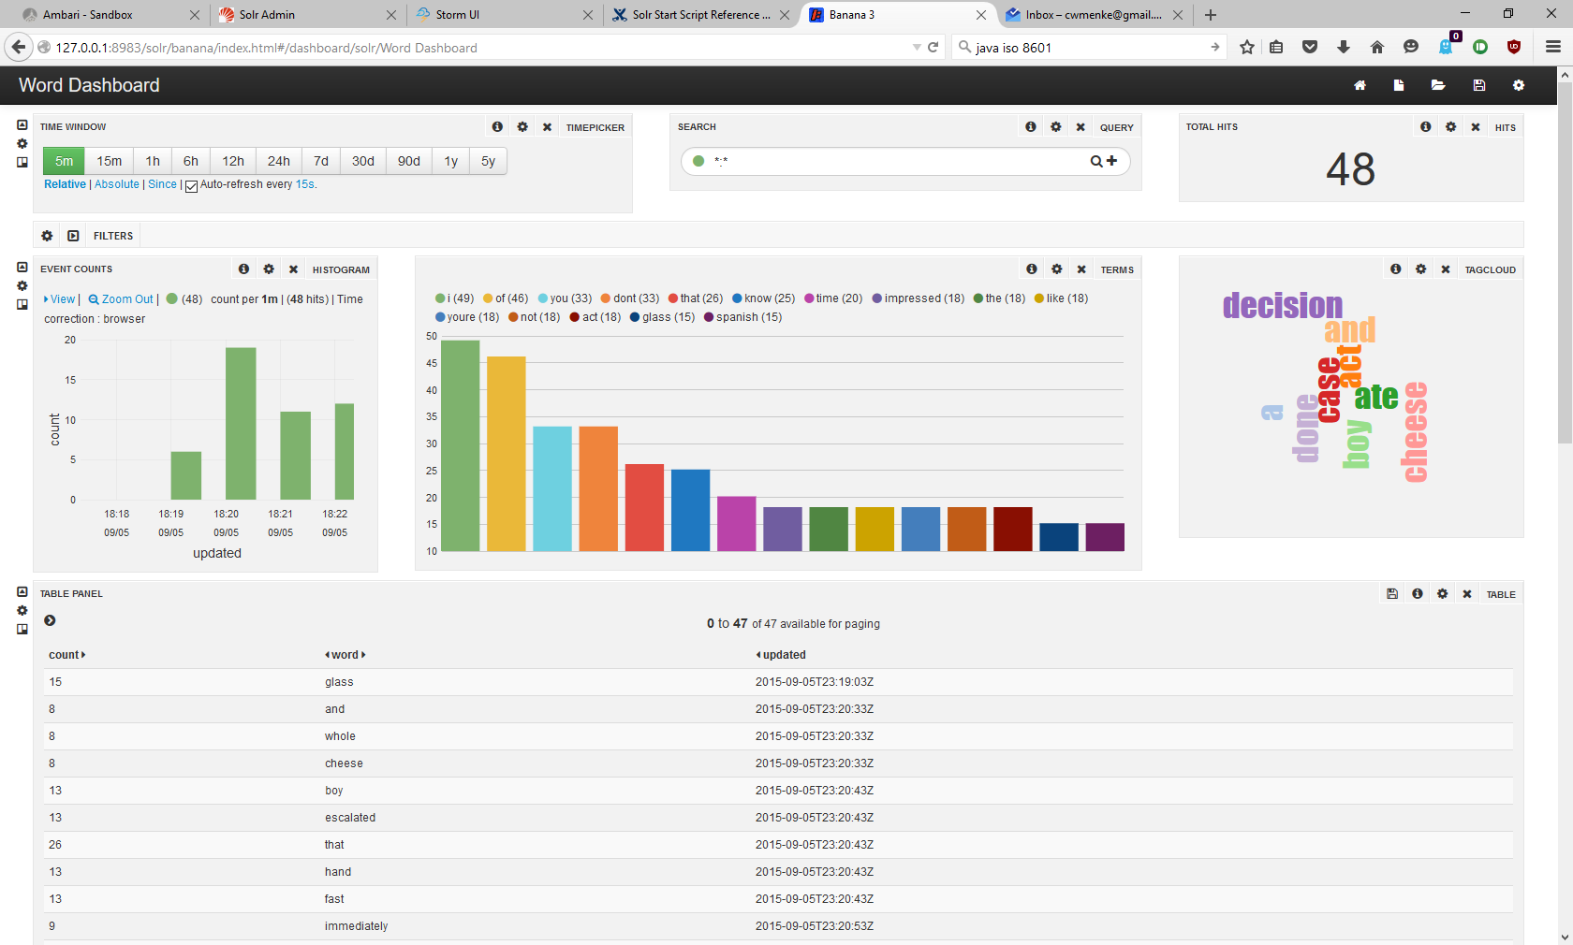
Demo

Slide 11
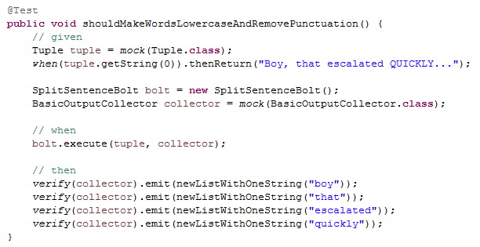
TestinG
Unit Testing
Depend on unit tests from the start, Mockito is your friend
Identify logic problems as early as possible
Find a bug? Create a unit test!
Notes:
Seriously depend on unit tests. Much easier to run a unit test in Eclipse than run through an entire deployment process just to find out there is a bug in your logic.
Integration

Slide 12
Testing part 2
Integration Testing
Connections to HDFS, Hbase, Solr, Relational DB…
Find: configuration and environment problems
Load Testing
Complete end to end test with load comparable to PROD
Find: bolts which need optimization, environment settings to optimize

Slide 13
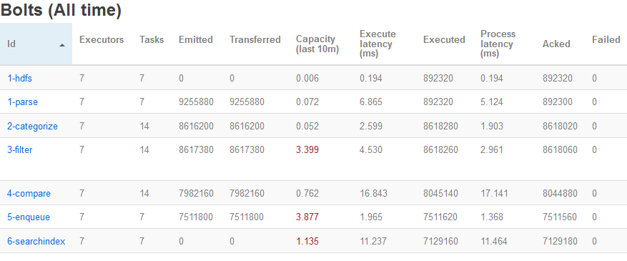
PRODUCTION DeploymenT
Uber-jar packaged up and deployed to cluster
Numbers of Storm nodes/workers/executors/tasks
Make this configurable
Based on results from testing
Notes:
Should be based on your testing in DEV

Slide 14
Production Deployment
Tolerate errors and outages
Updating a topology
Configuration over code
Increasing load over time
Logging and debugging a running topology
When Nimbus / supervisor / worker dies…
Common problems:
Conflicting workloads
Configuration issues (ex: ULIMIT for storm user)
Notes:
Updates to a topology which is running 24/7
Easier to reload a config periodically than make a code change, rebuild, take an outage to redeploy
Use the Storm UI to identify potential problem areas
Logging in storm is extremely important, log ERRORS to the Storm UI where they are easily visible. Log what else is necessary as INFO using SLF4J
Configuration issues: Ulimits for Storm

Slide 15
Resources
Storm: http://storm.apache.org/
https://github.com/kitmenke/storm-stlhug-demo
http://hortonworks.com/hadoop/storm/
Kit Menke’s Blog (@kitmenke)
Getting started with Storm: Logging
Tick tuples within Storm
Adam Doyle (@mypetrock)

Slide 16
Questions

